Slide 1
Shivranjani ( The Music Society ) Website
Name : Tarun Joshi
College Roll No : 20222760
University Roll No : 22020107041
Course : B. Vocation Software Development
Subject : Minor Project

Slide 2
Introduction
Welcome to the official website of the Shivranjani Music Society! We are dedicated to bringing together passionate musicians, music lovers, and artists from all walks of life to celebrate the universal language of music. Whether you are a performer, a listener, or simply someone interested in learning more about the world of music, our community offers something for everyone.

Slide 3
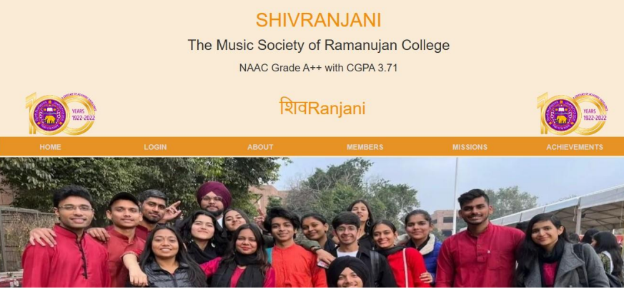

Slide 4
Objectives of the Website
The main objective of the website is to provide an organized digital space for managing and promoting the activities of the Shivranjani Music Society. It ensures smooth communication between members, showcases upcoming events, and highlights the society's mission and achievements. The website also aims to enhance the visibility of the society by making its resources and goals accessible online.

Slide 5
Technologies Used
This project integrates modern web development tools to ensure scalability, security, and responsiveness. The backend is powered by Django, a Python framework known for its robustness and speed. Frontend design uses HTML5, CSS3, and Bootstrap for a mobile-first and user-friendly interface. JavaScript adds interactivity, while the Django database (SQLite/PostgreSQL) handles data storage for events, member details, and other dynamic content.

Slide 6
Key Features of the Website
The website boasts several innovative features:
Responsive Design: Works seamlessly across devices with a Bootstrap framework.
Dynamic Content Management: Django ORM ensures smooth integration of data like event schedules.
Interactive Features: JavaScript-powered elements like event notifications and music samples.
Secure User Login: A dedicated login system protects sensitive information and ensures role-based access.

Slide 7
Creating the Website Structure
The website follows a structured approach using Django’s MVT (Model-View-Template) architecture. The database is designed to store user data, event details, and multimedia content. Templates were created to design pages like Home, About, Mission, Members, and Achievements. The admin interface simplifies data management, enabling administrators to update content easily.

Slide 8
Use Case of the Website
This website is designed to streamline the management and communication processes for the Shivranjani Music Society. It allows members to register, view event details, and share their profiles. Administrators can update the mission, add events, and track member contributions. Visitors can explore public content, learn about the society, and engage with the musical community.

Slide 9
Development Workflow
The development process began with setting up a Django project and creating a virtual environment for managing dependencies. The structure was built by dividing functionalities into Django apps. A database was integrated using Django ORM, and the frontend was designed using Bootstrap for responsiveness. Migration files were created to sync the database schema with the models.

Slide 10
Entity-Relationship (ER) Diagram
The ER diagram highlights the relationships between key entities such as Users, Login Sessions, Private Information, and the Mission. Each user has a unique ID and password, which links to multiple login sessions. Logged-in users can access private information. The mission data is centrally managed and displayed for all users.

Slide 11
Data Flow Diagram (DFD)
The data flow begins with users interacting with the website interface. Requests are processed by the Django backend, and content is fetched dynamically from the database. Administrators manage data through the admin panel, ensuring that updates to events, member profiles, and multimedia are instantly reflected on the website.

Slide 12
Challenges Faced and Solutions
During the project, challenges included managing dynamic content and ensuring a secure login system. By using Django’s ORM and built-in authentication system, these challenges were effectively resolved. Another challenge was designing a responsive layout, which was achieved using Bootstrap. Regular testing ensured that the website worked smoothly across all devices.

Slide 13
Conclusion and Future Scope
The Shivranjani Music Society website successfully achieves its goals of providing a digital space for music enthusiasts. It is a secure, user-friendly platform that balances dynamic content with a collaborative community experience. In the future, features like live music streaming, advanced member analytics, and an AI-powered recommendation system can be integrated to enhance user engagement.

